Slide 1
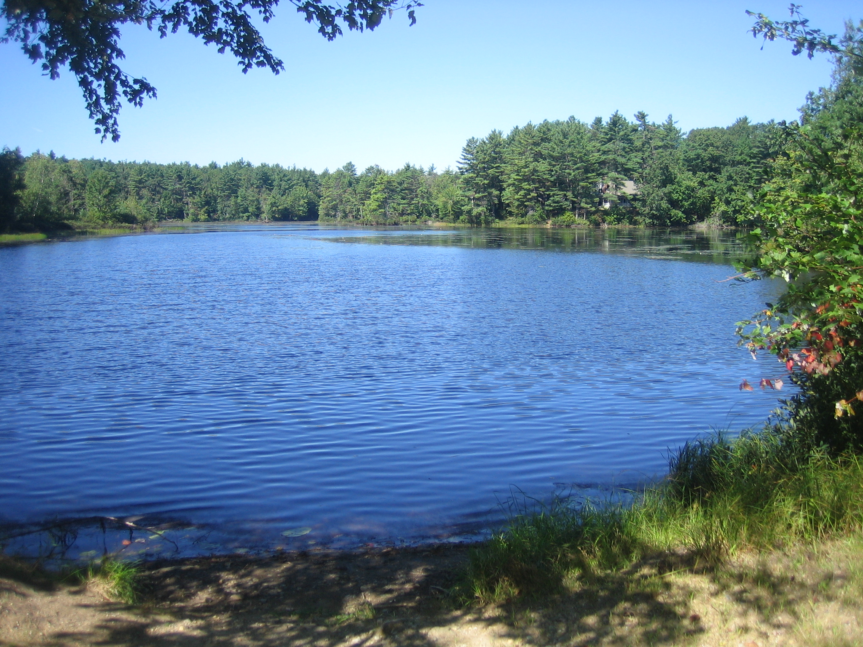

Slide 2
2016 Wachusett Shores And PPOA Meeting
Sunday May 1, 2016
2:00

Slide 3
Agenda
Welcome and Introduction to all Owners
Special Thanks
Minutes of 2015 PPOA Annual Meeting
Treasurer’s Report
Improvements
Barn Proceeds
Projected Budget FY 2017
New Business
Elections
Adjournment

Slide 4
Thanks for the few who volunteer to help run PPOA
PPOA Board of Directors and Associates
Jim Ellis for goose abatement and trail maintenance
Gail Orciuch for treasure’s duty and database
Bob and Sherry Brooks for Lodge rentals
Bill Holmans for plowing
Jay Began for mowing
Eric and Carol Goodhart and for entry board decorating
Brendan Toupense for being Webmaster
Betty Ann Sharp for presentations slides

Slide 5
Old Business
Goose egg treatment
Beach Cleanup
Maintenance Fee and PPOA membership Fee voted on and approved
August Beach Party

Slide 6
TOTAL NET WORTH
Real Estate $228,900
Total portfolio $204,070
Total assets $432,970
Total liability $0
Net worth $432,970

Slide 7
Annual Portfolio

Slide 8
Merrill Lynch Investments

Slide 9
Income
2016: 128 Payments = $15.5K
2015: 144 Payments = $11.4K
2014: 144 Payments = $12.6K
2013: 130 Payments = $13.0K
2012: 145 Payments = $13.7K
2011: 142 Payments = $14.2K

Slide 10
Operating Budget

Slide 11
Expenses As of March 31, FY 2016
EXPENSES | FY2016 PLAN | FY2016 ACTUAL YTD | VARIANCE
Taxes (Town & State) | $3,500.00 | $ 3,614.95 | $ (114.95)
United Site Services (Porta Potti) | $325.00 | $317.89 | $ 7.11
Comm Mass (Corp. Fee& Interest/Penalties) | $419.94 | $423.44 | $(3.50)
Verizon (Telephone) | $1,000.00 | $1,039.56 | $(39.56)
National Grid (Electric) | $2,000.00 | $1,498.79 | $501.21
Kristoff and Sons (Trash) | $200.00 | $157.00 | $43.00
Lodge Security | $216.00 | $216.00 | $0
USPS (Stamps) | $250.00 | $147.00 | $103.00
Broberg Insurance (Liability) | $5,585.00 | $5,585.00 | $0
Broberg Insurance (Lodge replacement) | $1,233.00 | $1,232.76 | $0.24
Huhtula Oil (Fuel) | $1,300.00 | $923.71 | $376.29
Dept. of Revenue 2014 Taxes | $ 811.00 | $811.00 | $0
US Dept. of Rev /State of Mass(Barn Proceeds) | $7,090.00 | $7,090.00 | $0
PO Box | $60.00 | $60.00 | $0
Beach water testing | $140.00 | $240.00 | $(100.00)
Web Site | $100.00 | $80.25 | $19.75
Lodge inspection: Town of Hubbardston | $40.00 | $42.00 | $(2.00)
Legal Fees | $1,000.00 | $100.00 | $ 900.00
Miscellaneous | $250.00 | $167.83 | $82.17
Tax Accountant | $1,225.00 | $1,225.00 | $0
Mailings/Meetings/Supplies | $250.00 | $46.86 | $203.14
Spring Cleanup/Annual Beach Party | $550.00 | $557.07 | $(7.07)
TOTAL OPERATING EXPENSES | $27,544.94 | $25,576.11 | $ 1,968.83

Slide 12
FY 2016 Maintenance & Improvements
* Paid for with Barn Proceeds
EXPENSES | FY 2016 Plan | FY 2016 Actual | Variance
Swing Set Canvas Replacement | $139.00 | * $139.00 | $0
Beach Sand | $455.05 | * $910.05 | $(455.00)
Lodge Septic Cleaning | $200.00 | $0 | $200.00
Lodge cleaning & supplies | $200.00 | $0 | $ 200.00
General Repairs (Lodge Pump, etc.) | $750.00 | $204.00 | $546.00
Tractor fuel & mowing supplies | $100.00 | $100.00 | $0
Safety Fencing at Dam | $1,700.00 | * $1,700.00 | $0
Lodge/Shed Roof Repairs | $7,000.00 | * $7,200.00 | $(200.00)
Lodge Exterior Wall Repair | $2,000.00 | * $1,970.00 | $30.00
Gas Grill | $350.00 | * $365.91 | $(15.91)
Beach Driveway Sealing | $1,300.00 | * $1,300.00 | $0
Pond Raking | $3,000.00 | $0 | $3,000.00
TOL . MAINT. & IMPROVEMENTS | $ 17,194.05 | $ 13,888.96 | $ 3,305.09
TOTAL OPERATING & MAINT/IMPROVEMENTS | $ 44,738.99 | $ 39,465.07 | $ 5,273.92

Slide 13
Income
 | FY 2016 Plan | FY 2016 Actual | Variance
FY 2015 Maint Fees (Plan: 189 x $68) | $12,852.00 | $8,604.00 | $(4,248.00)
FY 2015 Memberships (Plan: 189 x $100) | $18,900.00 | $6,226.06 | $(12,673.94)
Past Due Maint Fees / Interest | $0 | $730.47 | $730.47
Lodge Rentals | $1,450.00 | $700.00 | $(750.00)
Lions Lodge Rental | $350.00 | $350.00 | $0
Interest (GFA Checking) | $1.00 | $1.14 | $0.14
Interest (GFA Savings) | $4.00 | $60.35 | $56.35
Dock Fees | $150.00 | $150.00 | $0
SUBTOTAL OPERATING INCOME | $33,707.00 | $16,822.02 | $(16,884.98)
US Dept. of Treasury Refund | $0 | $4,605.67 | $4,605.67
TOTAL INCOME | $33,707.00 | $ 21,427.69 | $(12,279.31)
Merrill Lynch Withdrawal (June/Barn) | $15,000.00 | $15,000.00 | $0
Merrill Lynch Withdrawal (Aug/Taxes) | $10,000.00 | $10,000.00 | $0
Total Withdrawal from Investments (Barn Proceeds) | $25,000.00 | $25,000.00 | $0
TOTAL | $58,707.00 | $46,427.69 | $ 12,279.31

Slide 14
Treasurer’s Report
March 31, 2016
Account | Portfolio Total: | FYTD Income/ Interest Earned
GFA Checking | $10592.17 | $0.14
GFA Savings | $3669.10 | $0.31
Total GFA Accounts | $14,261.27
Merrill Lynch Investments | $181,583.90
Merrill Lynch Cash Balance | $8225.00
Total Merrill Lynch | $189,808.90
TOTAL | $204,070.17

Slide 15
PPOA IMPROVEMENTS
FY 2016

Slide 16
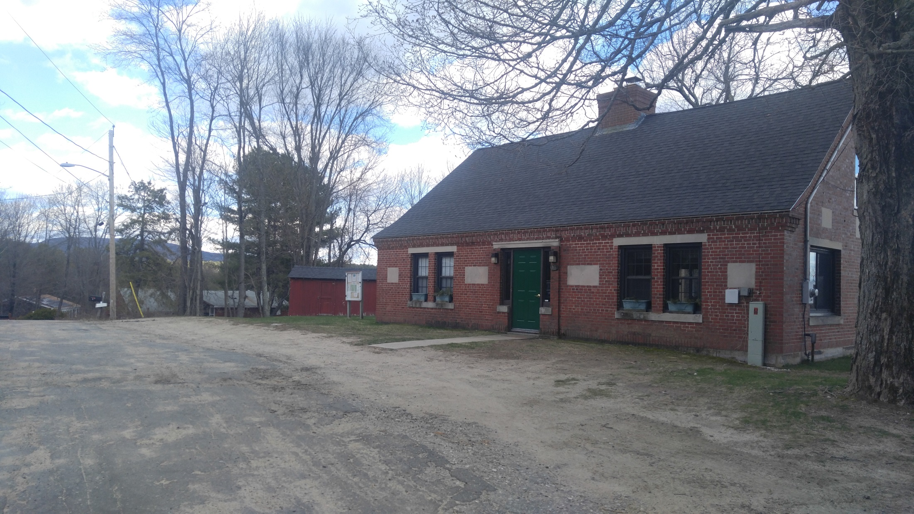

Slide 17
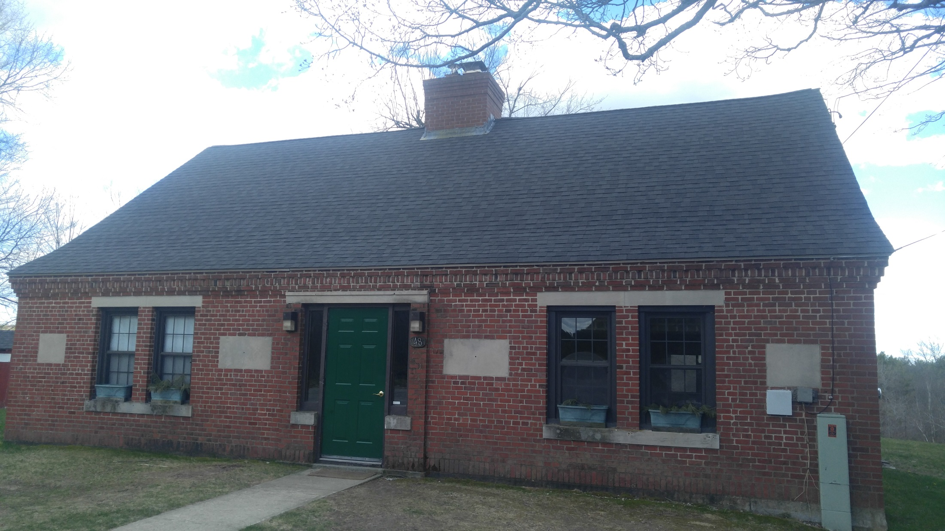

Slide 18
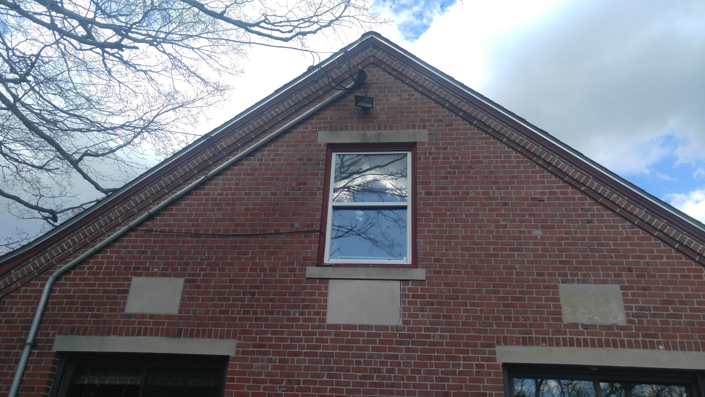

Slide 19
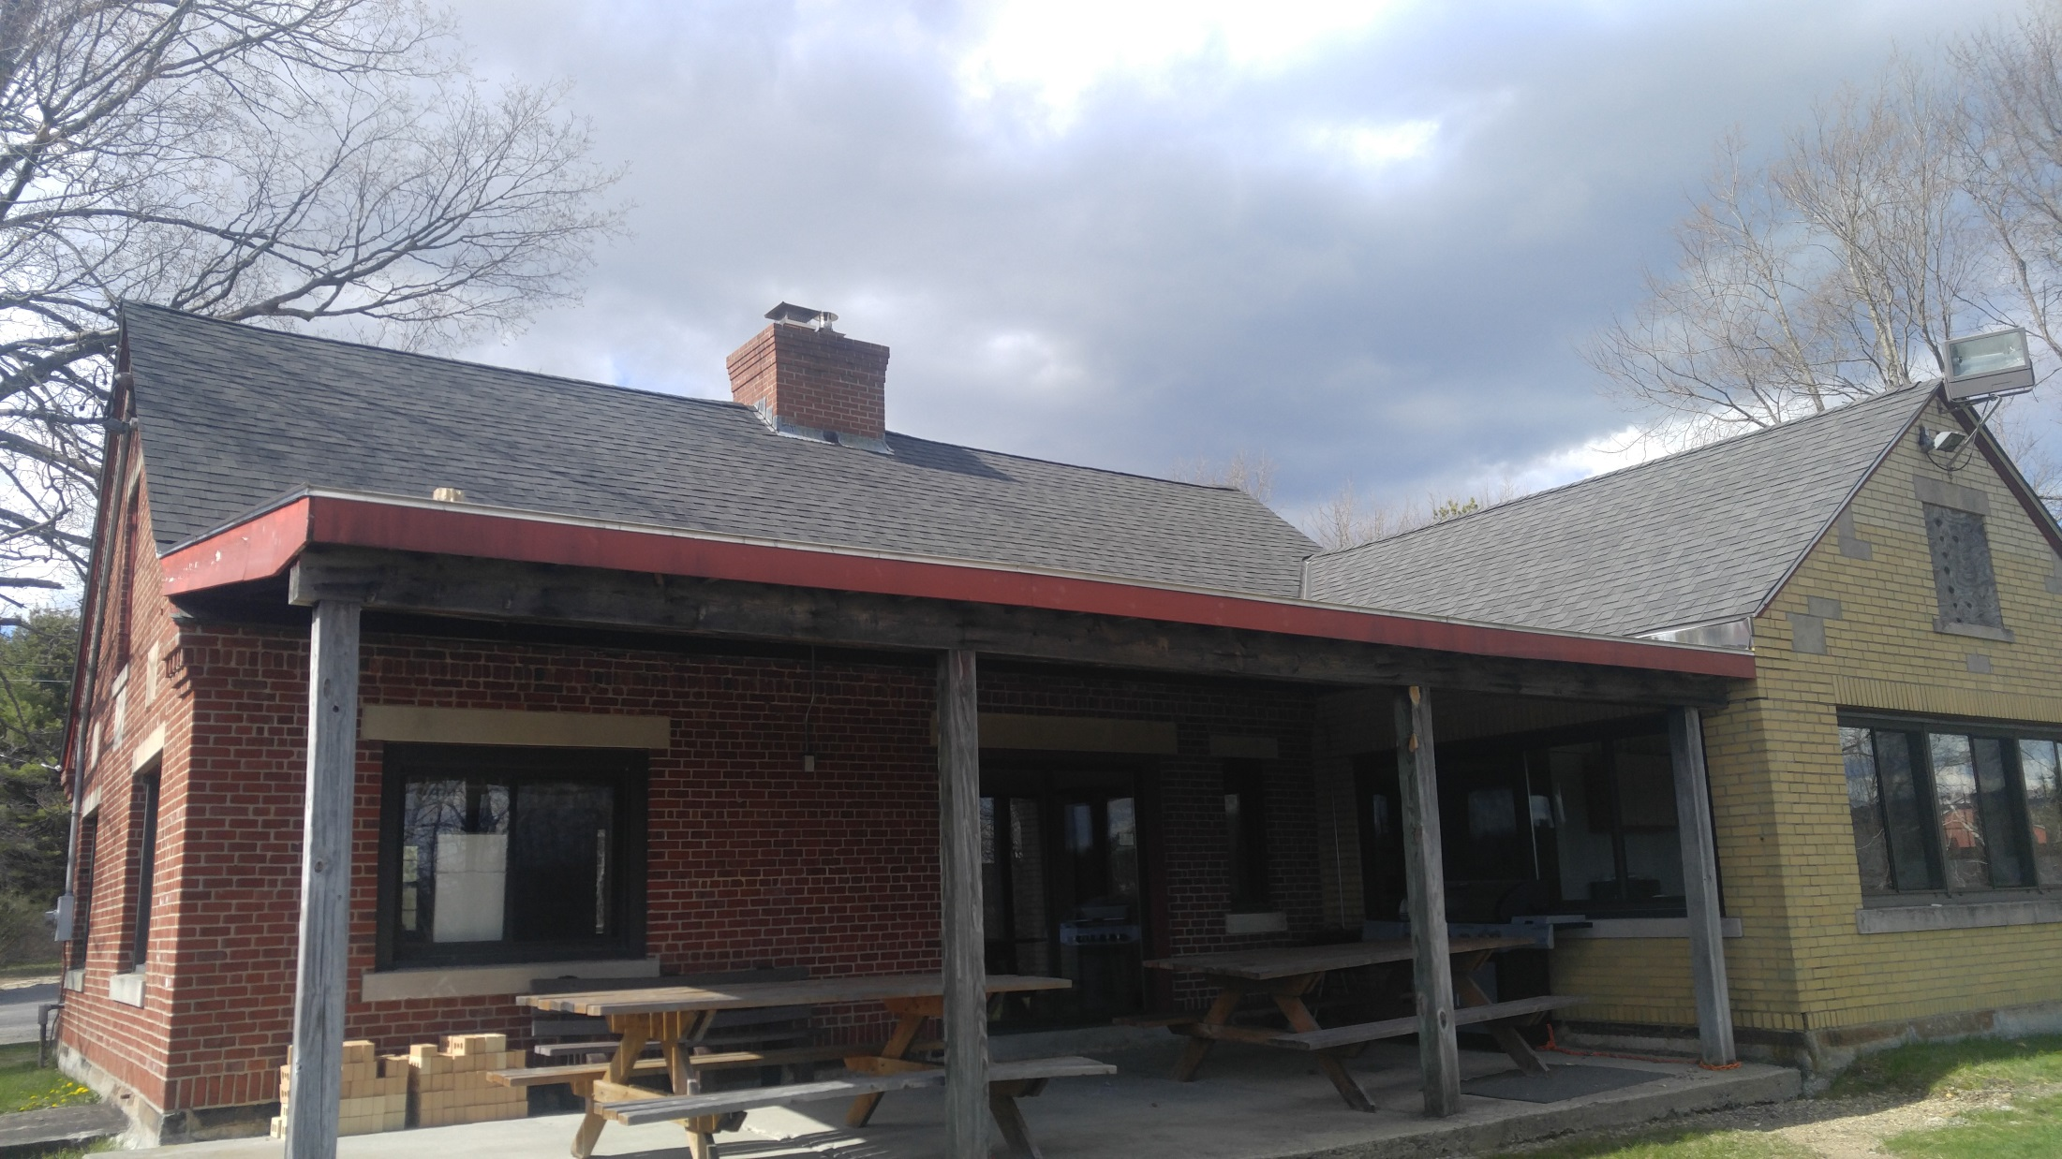

Slide 21
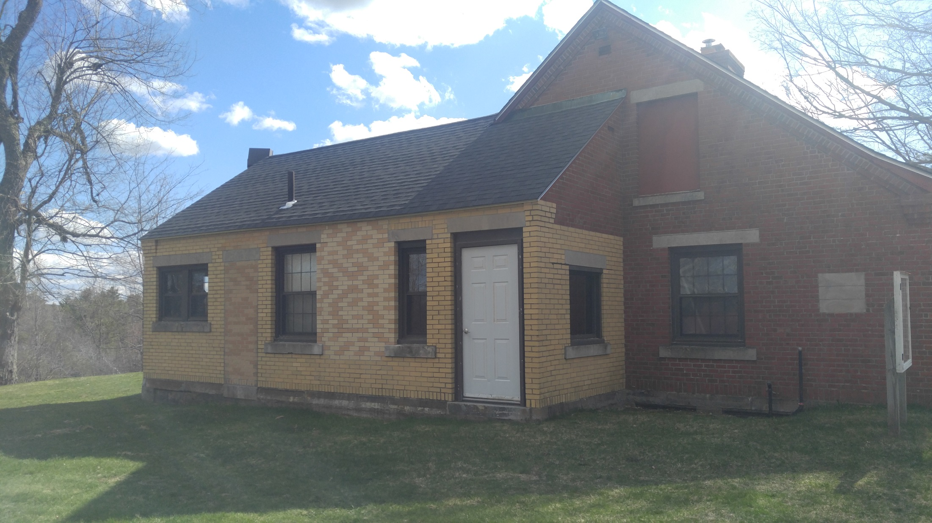

Slide 22
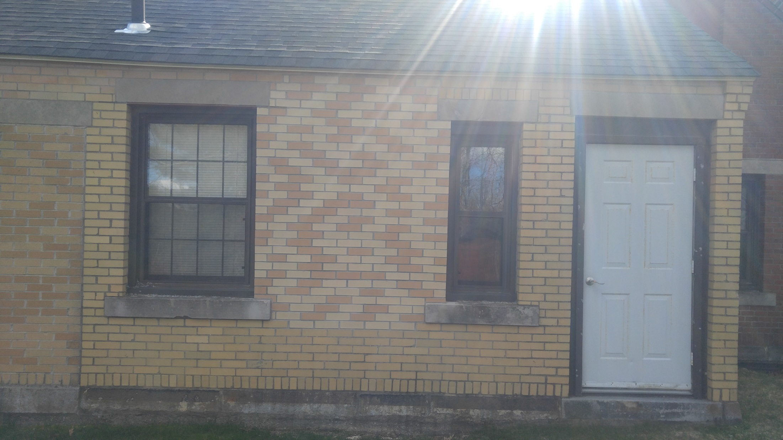

Slide 23
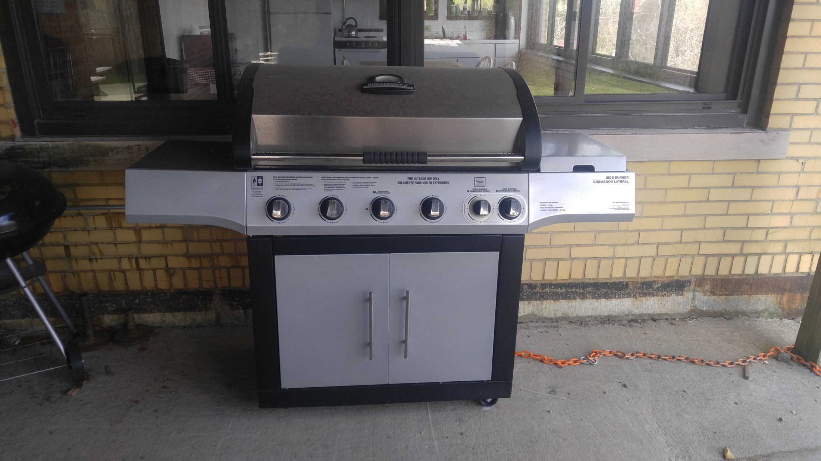

Slide 24
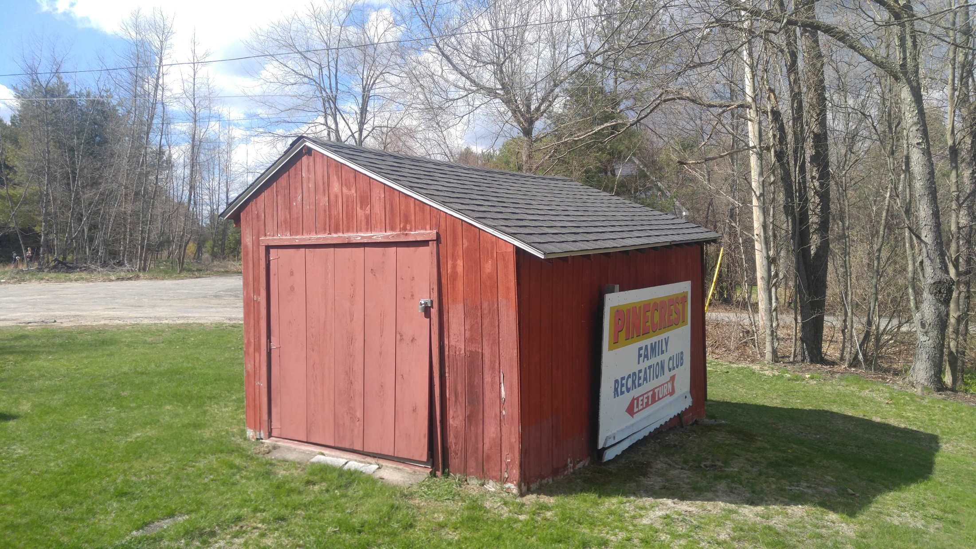

Slide 25
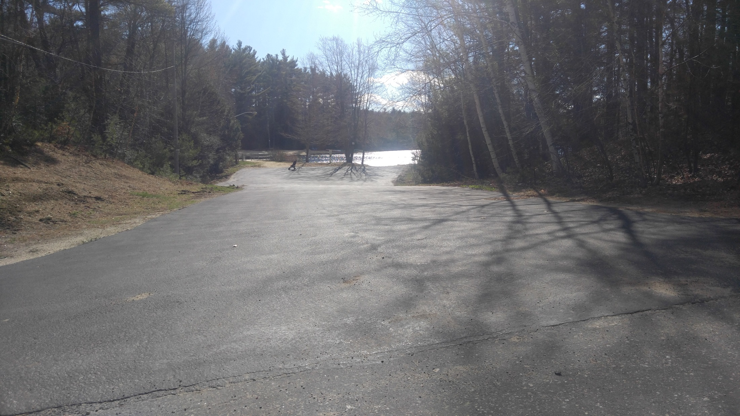

Slide 26
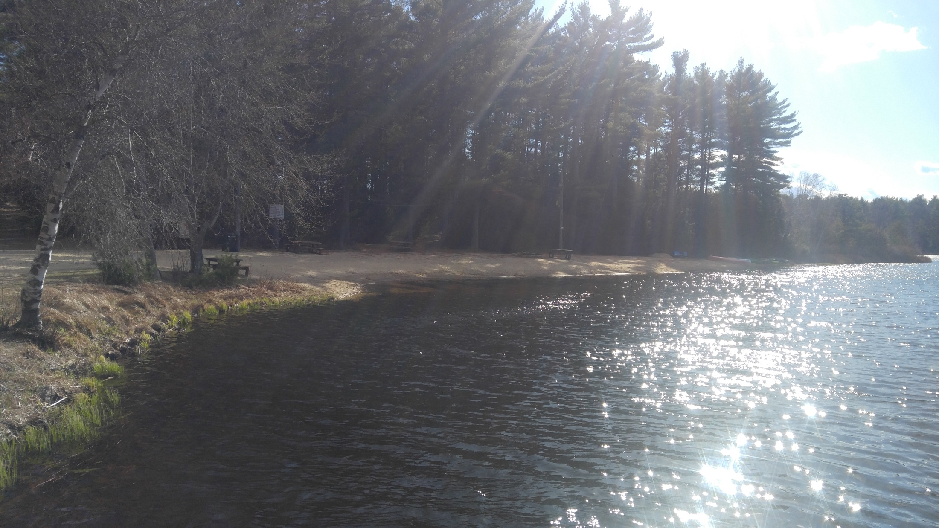

Slide 27
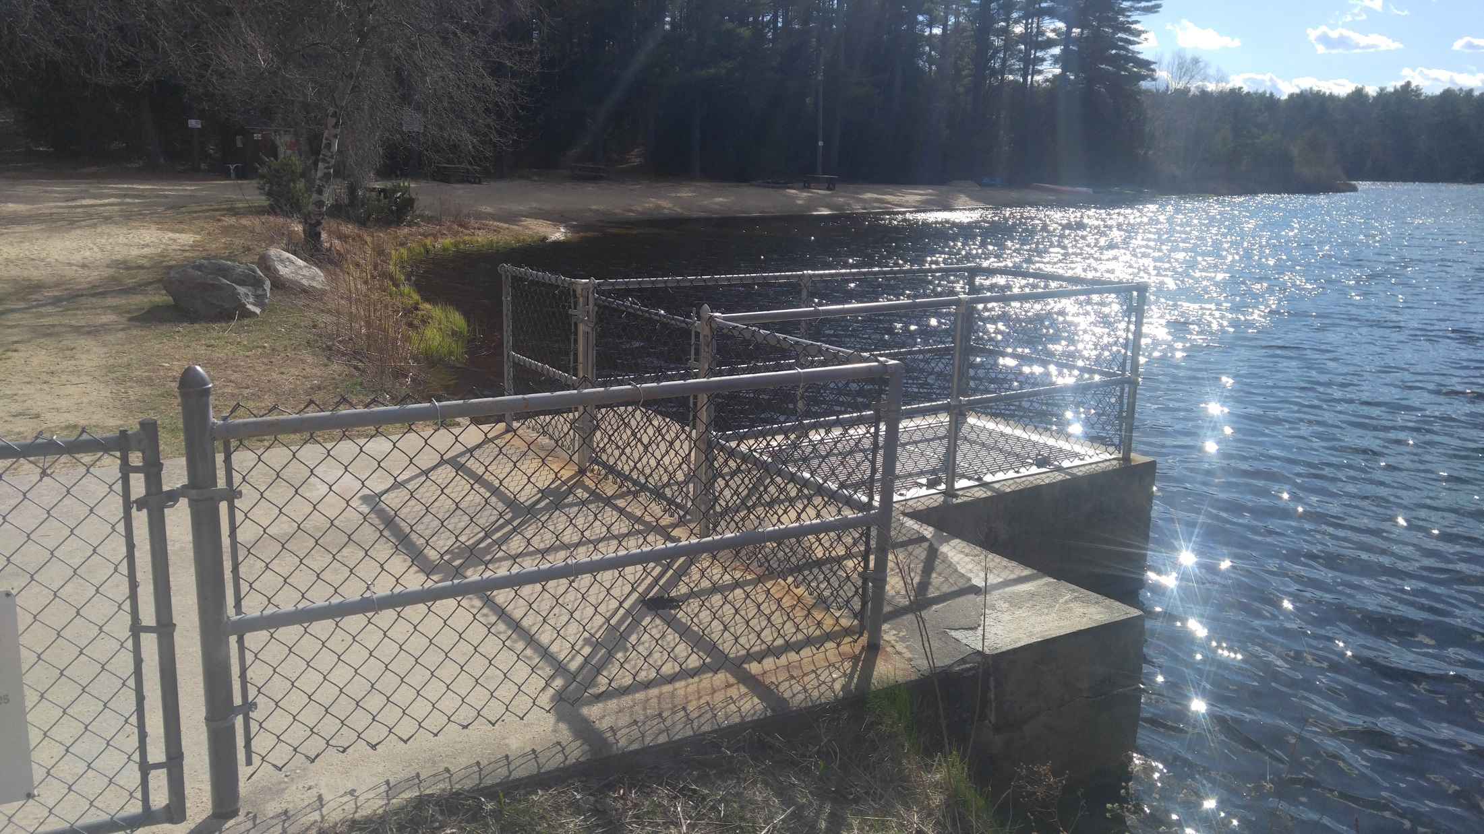

Slide 28
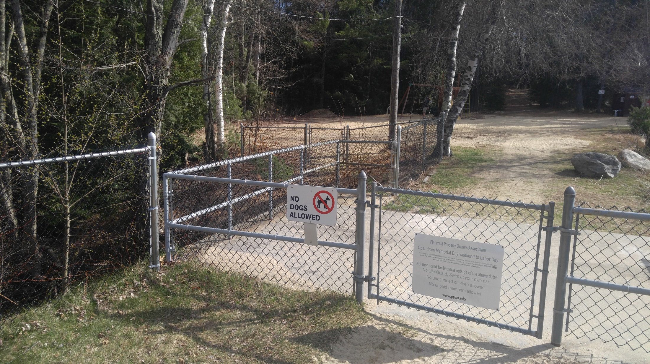

Slide 29
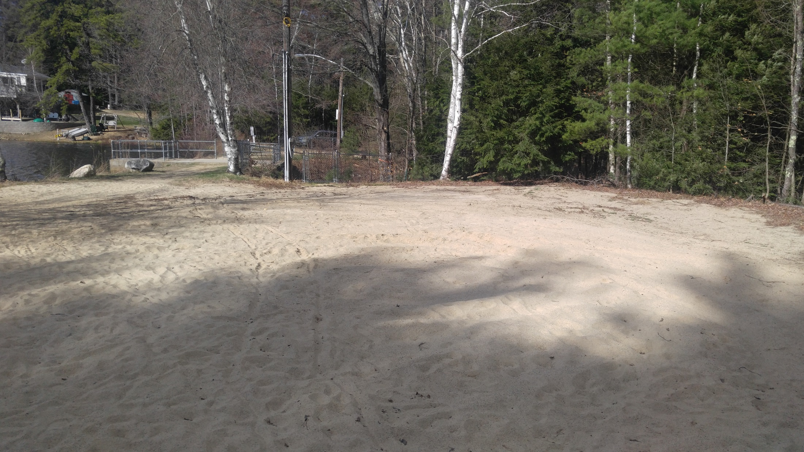

Slide 30
Barn Proceeds with Expenditures
DATE | ITEM | AMOUNT | BALANCE
8/21/2012 | Net Proceeds |  | $69,498.88
 | Lot Survey for 2 Acres | $1,975.00 | $67,523.88
 | Tax for 61B Land | $244.10 | $67,279.78
 | Kristoff Clean & Haul Debris | $1,000.00 | $66,279.78
 | Atty Fees Brekka & Brekka | $2,547.85 | $63,731.93
9/11/2012 | J. Garrity-Dam Repair Materials | $84.07 | $63,647.86
11/20/2012 | J. Bigwood-Lodge Chimney Seal | $150.00 | $63,497.86
11/25/2012 | Tighe & Bond-Dam Engineering Study | $2,950.00 | $60,547.86
12/12/2012 | Aquatic Control Tech-Pond Treatment | $2,250.00 | $58,297.86
2/11/2013 | Tighe & Bond-Dam Engineering Study | $1,180.00 | $57,117.86
3/4/2013 | Tighe & Bond-Dam Engineering Study | $590.00 | $56,527.86
4/15/2013 | S. Begin-Beach Sand Work (1/2 payment) | $325.00 | $56,202.86
4/15/2013 | B. Buoniconti-Beach Sand Work (1/2 payment) | $100.00 | $56,102.86
4/15/2013 | Graves-Beach Sand | $383.80 | $55,719.06
4/18/2013 | S. Begin-Beach Sand Work (final payment) | $325.00 | $55,394.06
4/18/2013 | B. Buoniconti-Beach Sand Work (final payment) | $75.00 | $55,319.06
5/10/2013 | Tighe & Bond-Dam Engineering Study | $390.00 | $54,929.06
5/15/2013 | NE Backyards - Beach Playset | $2,857.06 | $52,072.00
5/21/2013 | Tighe & Bond-Dam Engineering Study | $2,700.00 | $49,372.00
7/22/2013 | Tighe & Bond-Dam Engineering Study | $1,620.00 | $47,752.00
12/6/2013 | Gagne Pump Co-Lodge Pump Repair | $222.00 | $47,530.00
1/8/2014 | Tighe & Bond-Dam Engineering Study | $1,370.00 | $46,160.00
3/9/2014 | Atty Feeds Matthew Campobasso, Esq. | $900.00 | $45,260.00
7/14/2014 | Atty Fees Brekka & Brekka | $2,307.75 | $42,952.25
10/26/2014 | B. Brooks-Dam Repair Materials | $66.25 | $42,886.00
11/4/2014 | B. Brooks-Dam Repair Materials | $241.47 | $42,644.53

Slide 31
Barn Proceeds with Expenditures
5/11/2015 | Eastern Jungle Gym - Swing Tent Cover | $139.00 | $42,505.53
5/14/2015 | Graves-Beach Sand | $407.50 | $42,098.03
6/5/2015 | Graves-Beach Sand | $47.55 | $42,050.48
7/7/2015 | Gas Grill for Lodge | $365.91 | $41,684.57
7/9/2015 | Beach Driveway Crack Fill & Driveway Sealing | $1,300.00 | $40,384.57
7/11/2015 | Safety Fencing at Dam | $1,700.00 | $38,684.57
7/18/2015 | Lodge Roof - Dean Fournier | $5,000.00 | $33,684.57
8/4/2015 | Lodge Roof Balance - Dean Fournier | $2,200.00 | $31,484.57
8/8/2015 | Graves-Beach Sand | $455.00 | $31,029.57
8/9/2015 | Lodge Brick Siding Replacement | $1,970.00 | $29,059.57

Slide 32
Estimated FY'2017 Expenses
Broberg Insurance (Liability) | $ 5,640.00
Lien Fees (60 @ $75 each) | $ 4,500.00
Town Property Taxes | $ 3,625.00
Broberg Insurance (Lodge replacement) | $ 1,300.00
Huhtula Oil (Fuel) | $ 1,300.00
Tax Accountant | $ 1,250.00
Verizon (Telephone Lodge & Beach) | $ 950.00
National Grid (Electric) | $ 800.00
Spring Cleanup/Annual Beach Party | $ 600.00
Legal Fees | $ 500.00
Miscellaneous Expenses | $ 350.00
United Site Services (Porta Potti) | $ 325.00
Annual Meeting Supplies | $ 200.00
PO Box & Postage | $ 400.00
Dept. of Revenue 2017 Taxes | $ 250.00
US Dept. of Rev /State of Mass | $ 250.00
Lodge Security | $ 225.00
Kristoff and Sons (Trash) | $ 180.00
Beach water testing | $ 200.00
PPOA Web Site | $ 100.00
Comm Mass Corp. Fee | $ 40.00
Lodge inspection: Town of Hubbardston | $ 40.00
SUBTOTAL OPERATING EXPENSES | $ 23,025.00

Slide 33
FY 2016 Maintenance & Improvements
Lodge Well Line Repair | $ 1,500.00
General Repairs @ Lodge | $ 750.00
Beach Sand | $ 350.00
Swing Set Repair | $ 250.00
Lodge Septic Cleaning | $ 250.00
Lodge cleaning & supplies | $ 200.00
Tractor fuel & mowing supplies | $ 100.00
TOT. MAINTENANCE & IMPROVEMENTS | $ 3,400.00

Slide 34
Income
INCOME |  | 2017 PLAN
Lodge Rentals |  | $750.00
Dock Fees |  | $150.00
Interest (GFA Savings) |  | $50.00
Interest (GFA Checking) |  | $1.00
TOTAL INCOME |  | $951.00
TOTAL EXPENSES |  | $26,425.00
EXPENSES LESS INCOME |  | $25,474.00
$135
(Note: $134.78 = $25,474.00 divided by 189 Property Owners)

Slide 35
New Business
  Spring Clean-up Saturday May 28 rain date Sunday May 29
  August 27th ~ Annual Summer Beach BBQ and games
  Lodge well Repair
  Proposed 2016 / 2017 Maintenance fee & Budget
  Vote and set the 2016 / 2017 Annual Maintenance fee vote
  Pinecrest Property Owners Association membership fee 2016/ 2017

Slide 36
Open Positions
Open Board of Directors Positions
Volunteers needed for Associates

Slide 37
Thank You

