Slide 1
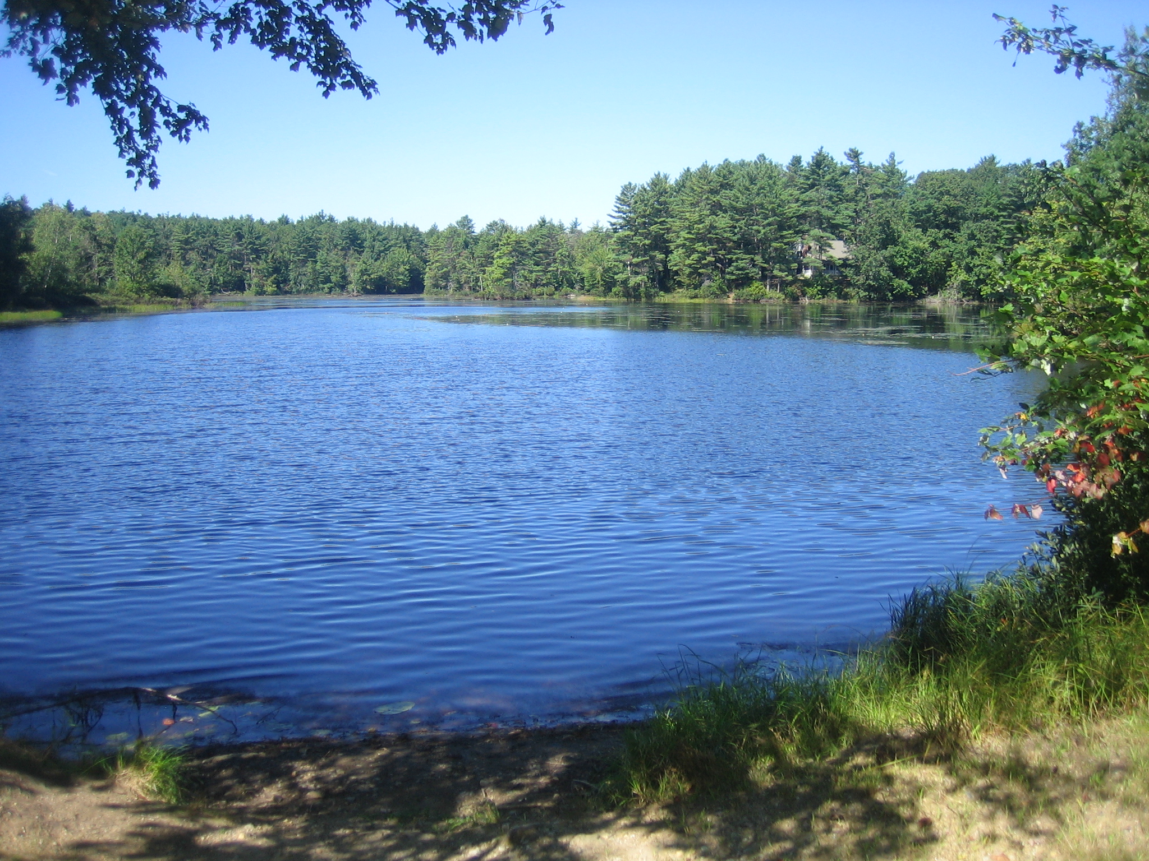

Slide 2
2015 Wachusett Shores And PPOA Meeting
Sunday May 3, 2015
2:00

Slide 3
Agenda
Welcome and Introduction to all Owners
Special Thanks
Minutes of 2014 Wachusett Shores & PPOA Annual Meetings
Old Business
Treasurer’s Report
Pond Preservation Presentation
Barn Proceeds
New Business
Maintenance Fee and Budget FY 2016
Elections
Adjournment

Slide 4
  Thanks for the few who volunteer to help run PPOA
PPOA Board of Directors and Associates
Deb Daly for bi-weekly pond testing
Jim Ellis for goose abatement and trail maintenance
Toni Bradley and Jeff Meusser for database and mailing
Gail Orciuch for treasure’s duty and database
Bob and Sherry Brooks for Lodge rentals
Bill Holmans for plowing
Jay Began for mowing
Eric and Carol Goodhart and for entry board decorating
Brendan Toupense for being Webmaster
Betty Ann Sharp for presentations slides

Slide 5
Wachusett Shores General Meeting Minutes, May 4, 2014
PPOA President Bill Homans called the meeting to order at 3:00.
Dennis Majikas provided some history of Wachusett Shores and the origin of the $18 fee, explaining how the Pine Crest Property Owners Association came be the legal entity with the authority to maintain the property and collect revenue to maintain it. Under the laws governing the Association the time has come after twenty years to renew the “Covenants.” The list of covenants has been revised with the assistance of legal counsel to eliminate provisions that are out-dated or have been superseded by Hubbardston ordinances.
Bill Homans continued the discussion, explaining the need to change the fee situation to more effectively maintain the Pine Crest property. A general discussion developed concerning the legal issues concerning property liens. There was general sympathy to the view that the $18 fee was too low. Some objected to the lack of timely legal opinion; others that the submitted opinion was too vague.
A number of important measures were passed at this meeting:
Motion : Jim Ellis. To renew the revised covenants for another twenty years with the exception of the provision for the maintenance fee which will be open to revision every year . Seconded: Cathy Airoldi. Motion passed.
Motion: Mike Tobine. To increase the $18 maintenance fee by $50 to a total of $68. Seconded: Cathy Airoldi. Motion passed.

Slide 6
Wachusett Shores General Meeting Minutes, May 4, 2014
Motion: Andy LeMoine. To request legal assistance to examine all the implications regarding title insurance, and real estate sales in the event that liens are placed on property for failure to pay assessment fees. Seconded: Motion passed.
Motion: Cathy Airoldi. That the proposed new maintenance fee in any one year be sent out with the annual meeting notice—90 days ahead—every year with the budget details so it can be reviewed at the meeting. Seconded: Jim Ellis. Motion passed.
Wachusett Shores Meeting Adjourned: 4:45
Respectfully submitted,
Bob Cronin, Clerk

Slide 7
PPOA Annual Meeting Minutes, May 4, 2014
Meeting called to order: 4:55 (The PPOA meeting followed shortly after the Wachusett Shores meeting was adjourned.)
Review of the Minutes: The Minutes of the 2013 Annual Meeting were accepted as written.
Treasurer’s Report: The Treasurer’s Report was approved unanimously.
Bill Homans thanked Deb Daly for continuing to test the water at the pond in keeping with Health Department regulations.
Jim Ellis presented a power point presentation concerning the future of the pond if the area is not maintained. (eutrophication)
Another opinion will be obtained regarding the dam. A tree is scheduled for removal.
Jim Ellis will continue to addle the eggs of Canada geese.
As previously determined, the beach clean-up date will be May 17. (Rain date May 18.)
All presented Bi Law changes voted on and approved
Jim Ellis moved that the PPOA dues be $100 making a total of $168—assuming the new fee schedule becomes affirmed. Motion passed unanimously.
Bob Cronin is stepping down as Clerk and is replaced by Eric Goodheart. Dave Blad will stay on as a Director.
Bill Homans mentioned reviving the July beach party.
Meeting adjourned: 5:52 Respectfully submitted, Bob Cronin

Slide 8
Old Business
Goose egg treatment
Email instead of mailing
Dam Maintenance
Beach Cleanup
Bi-Law Changes
Maintenance Fee and PPOA membership Fee voted on and approved
July Beach Party

Slide 9
Treasurer’s Report
March 31, 2015
Account | Portfolio Total: | FYTD Income/ Interest Earned
GFA Checking | $978.83 | $0.31
GFA Savings | $1,561.91 | $3.26
Total GFA Accounts | $2,540.74
Merrill Lynch Investments | $208,337.48
Merrill Lynch Cash Balance | $15,907.69
Total Merrill Lynch | $224,245.17
TOTAL | $226,785.91

Slide 10
TOTAL NET WORTH
Real Estate $226,125
Total portfolio $226,786
Total assets $452,911
Total liability $0
Net worth $452,911

Slide 11
As of March 31, FY 2015
EXPENSES | FY 2015 Plan | FY 2015 Actual | Variance
Town of Hubbardston (Taxes) | $3,200.00 | $3,438.24 | -$238.24
United Site Services (Porta Potti) | $350.00 | $317.89 | $32.11
Comm. of Mass Annual Report Filing Fee | $15.00 | $15.00 | $0.00
Verizon (Telephone) | $825.00 | $930.45 | -$105.45
National Grid (Electric) | $555.00 | $688.03 | -$133.03
Kristoff and Sons (Trash) | $175.00 | $203.00 | -$28.00
Lodge Security | $300.00 | $310.94 | -$10.94
USPS (Stamps) | $100.00 | $201.88 | -$101.88
Broberg Insurance (Liability) | $5,530.00 | $5,530.00 | $0.00
Broberg Insurance (Lodge replacement) | $1,174.00 | $1,173.68 | $0.32
Huhtula Oil (Fuel) | $1,700.00 | $1,215.94 | $484.06
PO Box | $54.00 | $58.00 | -$4.00
Beach water testing | $150.00 | $140.00 | $10.00
Comm. of Mass (Tax Return) | $25.00 | $187.84 | -$162.84
Lodge inspection: Town of Hubbardston | $40.00 | $0.00 | $40.00
Legal Fees | $1,500.00 | $2,307.75 | -$807.75
Miscellaneous (Annual Meet/billing cost) | $308.00 | $50.00 | $258.00
Tax Accountant | $500.00 |  | $500.00
Lien Settlement Recording Fee | $75.00 | $0.00 | $75.00
Mailing/Meeting Supplies | $250.00 | $348.51 | -$98.51
Web Site | $70.00 | $95.05 | -$25.05
SUB TOTAL EXPENSE | $16,896.00 | $17,212.20 | -306.20

Slide 12
FY 2015 Maintenance & Improvements
EXPENSES | FY 2015 Plan | FY 2015 Actual | Variance
Lodge pump / Chimney / Furnace | $500.00 | $0.00 | $500.00
Beach Sand / Labor | $450.00 | $0.00 | $450.00
Lodge Septic Cleaning | $0.00 | $0.00 | $0.00
Lodge monthly cleaning & supplies | $200.00 | $36.00 | $164.00
Tractor fuel & mowing supplies | $75.00 | $41.74 | $33.26
Dam repair/maintenance |  | $307.72 | -$307.72
TOTAL MAINTENANCE & IMPROVEMENTS | $1,225.00 | $385.46 | $839.54
SUB TOTAL EXPENSE | $16,896.00 | $17,212.20 | -$316.20
TOTAL EXPENSES | $18,121.00 | $17,597.66 | $523.34

Slide 13
Income
 | FY 2015 Plan | FY 2015 Actual | Variance
Maintenance Fee ($18 x 192) | $3,456.00 | $2,528.00 | -$928.00
Membership Fee ($150 x 89) | $13,350.00 | $8,857.00 | -$4,493.00
Lodge Rentals | $500.00 | $1,150.00 | $650.00
Lions Lodge Rental | $700.00 | $350.00 | -$350.00
Interest (GFA Checking) | $5.00 | $0.31 | -$4.69
Interest (GFA Savings) | $5.00 | $3.26 | -$1.74
Dock Fees | $100.00 | $150.00 | $50.00
TOTAL INCOME | $18,116.00 | $13,038.57 | -$5,077.43

Slide 14
Withdrawal from investments to cover operating costs and expenditures
 | FY 2015 Plan | FY 2015 Actual | Variance
Total Withdrawal (July 2014) |  | $5,700.00 | $5,700.00

Slide 15
Cash Flow
 | FY 2015 Plan | FY 2015 Actual | Variance
TOTAL INCOME | $18,116.00 | $13,038.57 | -$5,077.43
TOTAL EXPENSES | $18,121.00 | $17,597.66 | $523.34
NET CASH FLOW | -$5.00 | -$4,559.09 | -$4,554.09

Slide 16
Merrill Lynch Investments

Slide 17
Annual Portfolio

Slide 18
Operating Budget

Slide 19
Income

Slide 20
Our Beautiful Pond

Slide 21
What is happening?
Lake aging is a natural process.
Lakes age at different rates depending upon:
  Nutrient runoff
  Tributary and other geological characteristics
Cushman Pond’s source is from a very nutrient rich swamp.
The shape of Cushman Pond is such that it has a large perimeter to surface area ratio.
Surveys have indicated substantial sediment accumulation.

Slide 22
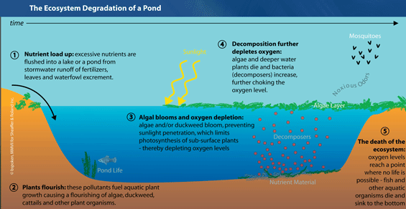

Slide 23
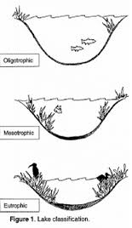
Source:WDBB3 “Lake Eutrophication – NH DEP

Slide 24
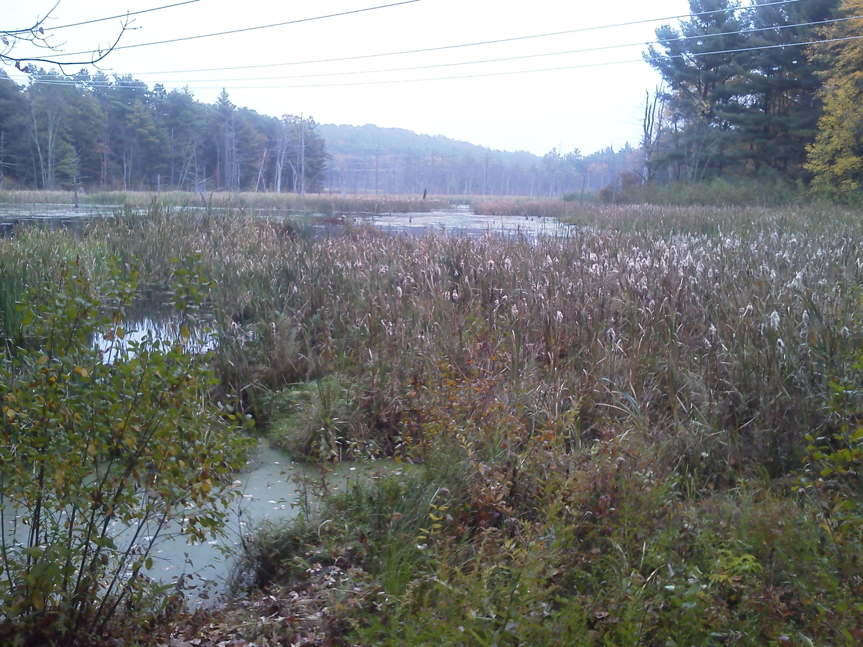
Eutrophication – our pond’s future if we do nothing
The future of our pond?

Slide 25
What do we need to do about it?
Dredge either dry or wet
  or
Raking
  or
Aeration
Note: Chemicals are not considered a long term solution

Slide 26
Maintenance & Improvements
Long term Planned Expenses | Total Expected Expenditure | 2015-16 Share | Total toward goal at year End 2016
Dredging / Weed Harvesting | $100,000.00 | $5,000.00 | $5,000.00
Dam Repair / Maintenance | $100,000.00 | $5,000.00 | $5,000.00
Total long-term Expenses | $200,000.00 | $10,000.00 | $10,000.00

Slide 27
Barn Proceeds with Expenditures
DATE | ITEM | CAPITAL IMPROVEMENT DOLLAR AMOUNT | BARN PROCEEDS BALANCE
8/12/12 | Net Proceeds |  | $69,498.88
2011 | Lot Survey for 2 Acres | $1,975.00 | $67,523.88
2011 | Tax for 61B Land | $244.10 | $67,279.78
2011 | Kristoff Clean & Haul Debris | $1,000.00 | $66,279.78
2011 | Atty. Fees Brekka & Brekka | $2,547.85 | $63,731.93
9/11/12 | J. Garrity-Dam Repair Materials | $84.07 | $63,647.86
11/20/12 | J. Bigwood-Lodge Chimney Seal | $150.00 | $63,497.86
11/25/12 | Tighe & Bond-Dam Engineering Study | $2,950.00 | $60,547.86
12/12/12 | Aquatic Control Tech-Pond Treatment | $2,250.00 | $58,297.86
2/11/13 | Tighe & Bond-Dam Engineering Study | $1,180.00 | $57,117.86
3/4/13 | Tighe & Bond-Dam Engineering Study | $590.00 | $56,527.86
4/15/13 | S. Begin-Beach Sand Work (1/2 payment) | $325.00 | $56,202.86
4/15/13 | B. Buoniconti-Beach Sand Work (1/2 payment) | $100.00 | $56,102.86
4/15/13 | Graves-Beach Sand | $383.80 | $55,719.06
4/18/13 | S. Begin-Beach Sand Work (final payment) | $325.00 | $55,394.06
4/18/13 | B. Buoniconti-Beach Sand Work (final payment) | $75.00 | $55,319.06
5/10/13 | Tighe & Bond-Dam Engineering Study | $390.00 | $54,929.06
5/15/13 | NE Backyards - Beach Play-set | $2,857.06 | $52,072.00
5/21/13 | Tighe & Bond-Dam Engineering Study | $2,700.00 | $49,372.00
7/22/13 | Tighe & Bond-Dam Engineering Study | $1,620.00 | $47,752.00
12/6/13 | Gagne Pump Co-Lodge Pump Repair | $222.00 | $47,530.00
1/8/14 | Tighe & Bond-Dam Engineering Study | $1,370.00 | $46,160.00
3/9/14 | Atty. Feeds Matthew Campobasso, Esq. | $900.00 | $45,260.00
7/14/14 | Atty. Fees Brekka & Brekka | $2,307.75 | $42,952.25
10/26/14 | B. Brooks-Dam Repair Materials | $66.25 | $42,886.00
11/4/14 | B. Brooks-Dam Repair Materials | $241.47 | $42,644.53
TBD | Safety Fencing for Dam | $1,700.00 | $40,944.53
TBD | Beach Sand | $400.00 | $40,544.53
TBD | Swing Set Tent Top Replacement | $199.00 | $40,345.53
 | 15% Tax Due on Balance Aug 1, 2015 (15%) |  | $6,081.68

Slide 28
Capital Expenditures from Dam Proceeds
Proposed
Lodge Exterior Brick Repairs | $2,000.00
Pond Chemical Treatments | $2,250.00
Lodge & 2 Sheds Roof Repairs | $7,000.00
TOTAL CAPITAL EXPENDITURES | $11,250.00 | $11,250.00
PROCEEDS BALANCE AFTER PROPOSED IMPROVEMENTS |  | $29,294.53
15% Tax Due After Proposed Improvements |  | $4,394.18

Slide 29
Capital Improvements
Barn Proceeds
Roof Repairs
Fencing
Sand for the Beach
Lodge Exterior Brick Repairs
Chimney Repairs
Pond
Dredging

Slide 30
New Business
Spring Clean-up Saturday May 16; rain date Sunday May 17 (cookout after)
Beach BBQ July 12
20 Year Pond Plan
Capital Improvements

Slide 31
ESTIMATED 2016 EXPENSES |  |  | ESTIMATED 2016 INCOME |  | PROPOSED FY2016 ANNUAL MAINTENANCE FEE
Liability Insurance | $ 5,760.00 |  |  |  | $145.28
Lodge Insurance | $ 1,300.00 |  | Lodge Rentals | $1,250.00
Property Taxes | $ 3,500.00 |  | Lions Lodge Rental | $700.00 | ($145.28 = $27,458.67 divided by 189 Property Owners)
State Taxes | $ 177.00 |  | INCOME | $ 1,950.00
Legal | $ 1,000.00
Tax Accoutant | $ 250.00 |  | TOTAL EXPENSES | $ 29,408.67
Hutula/Lodge Oil | $ 1,000.00
Telephone | $ 1,000.00 |  | EXPENSES LESS INCOME | $ 27,458.67
Electric | $ 700.00
Annual Meeting/Mailing Costs | $ 250.00
USPS Stamps | $ 250.00
Portable Toilet | $ 325.00
Beach water testing | $ 140.00
Trash | $ 200.00
Lodge Security | $ 325.00
Lodge Maint (Furnace, Pump, Plumbing) | $ 350.00
Lodge cleaning & supplies | $ 75.00
Tractor fuel & mowing supplies | $ 75.00
Web Site | $ 100.00
PO Box | $ 60.00
Lodge inspection | $ 40.00
Comm of Mass Corporation Fee | $ 15.00
Pond Chemical Treatments | $ 2,250.00
EXPENSES | $ 19,142.00
 | Per Occurrence | Annualized
Beach sand every 2 years | $ 400.00 | $ 200.00
Lodge Septic Cleaning every 3 years | $ 200.00 | $ 66.67
Dam repair/emergency fund over 20 years | $ 100,000.00 | $ 5,000.00
Dredge/Weed harvesting Once over 20 years | $ 100,000.00 | $ 5,000.00
AMORTIZED / LARGER EXPENSES |  | $ 10,266.67
TOTAL EXPENSES | $ 29,408.67

Slide 32
2016 Maintenance and Membership Fee
$145— One fee for PPOA and Wachusett Shores

Slide 33
Open Positions
At least 5 Open Board of Directors Positions
Volunteers needed for Associates

Slide 34
Thank You

Slide 36
Option 2 |  |  | ESTIMATED 2016 INCOME |  | PROPOSED FY2016 ANNUAL MAINTENANCE FEE
Liability Insurance | $ 5,760.00 |  |  |  | $92.37
Lodge Insurance | $ 1,300.00 |  | Lodge Rentals | $1,250.00
Property Taxes | $ 3,500.00 |  | Lions Lodge Rental | $700.00 | ($92.37 = $27,458.67 divided by 189 Property Owners)
State Taxes | $ 177.00 |  | INCOME | $ 1,950.00
Legal | $ 1,000.00
Tax Accoutant | $ 250.00 |  | TOTAL EXPENSES | $ 19,408.67
Hutula/Lodge Oil | $ 1,000.00
Telephone | $ 1,000.00 |  | EXPENSES LESS INCOME | $ 17,458.67
Electric | $ 700.00
Annual Meeting/Mailing Costs | $ 250.00
USPS Stamps | $ 250.00
Portable Toilet | $ 325.00
Beach water testing | $ 140.00
Trash | $ 200.00
Lodge Security | $ 325.00
Lodge Maint (Furnace, Pump, Plumbing) | $ 350.00
Lodge cleaning & supplies | $ 75.00
Tractor fuel & mowing supplies | $ 75.00
Web Site | $ 100.00
PO Box | $ 60.00
Lodge inspection | $ 40.00
Comm of Mass Corporation Fee | $ 15.00
Pond Chemical Treatments | $ 2,250.00
EXPENSES | $ 19,142.00
 | Per Occurrence | Annualized
Beach sand every 2 years | $ 400.00 | $ 200.00
Lodge Septic Cleaning every 3 years | $ 200.00 | $ 66.67
Dam repair/emergency fund over 20 years
Dredge/Weed harvesting Once over 20 years
AMORTIZED / LARGER EXPENSES |  | $ 266.67
TOTAL EXPENSES | $ 19,408.67

Slide 37
Option 3 |  |  | ESTIMATED 2016 INCOME |  | PROPOSED FY2016 ANNUAL MAINTENANCE FEE
Liability Insurance | $ 5,760.00 |  |  |  | $80.47
Lodge Insurance | $ 1,300.00 |  | Lodge Rentals | $1,250.00
Property Taxes | $ 3,500.00 |  | Lions Lodge Rental | $700.00 | ($80.47 = $27,458.67 divided by 189 Property Owners)
State Taxes | $ 177.00 |  | INCOME | $ 1,950.00
Legal | $ 1,000.00
Tax Accoutant | $ 250.00 |  | TOTAL EXPENSES | $ 17,158.67
Hutula/Lodge Oil | $ 1,000.00
Telephone | $ 1,000.00 |  | EXPENSES LESS INCOME | $ 15,208.67
Electric | $ 700.00
Annual Meeting/Mailing Costs | $ 250.00
USPS Stamps | $ 250.00
Portable Toilet | $ 325.00
Beach water testing | $ 140.00
Trash | $ 200.00
Lodge Security | $ 325.00
Lodge Maint (Furnace, Pump, Plumbing) | $ 350.00
Lodge cleaning & supplies | $ 75.00
Tractor fuel & mowing supplies | $ 75.00
Web Site | $ 100.00
PO Box | $ 60.00
Lodge inspection | $ 40.00
Comm of Mass Corporation Fee | $ 15.00
Pond Chemical Treatments
EXPENSES | $ 16,892.00
 | Per Occurrence | Annualized
Beach sand every 2 years | $ 400.00 | $ 200.00
Lodge Septic Cleaning every 3 years | $ 200.00 | $ 66.67
Dam repair/emergency fund over 20 years
Dredge/Weed harvesting Once over 20 years
AMORTIZED / LARGER EXPENSES |  | $ 266.67
TOTAL EXPENSES | $ 17,158.67

