Slide 1
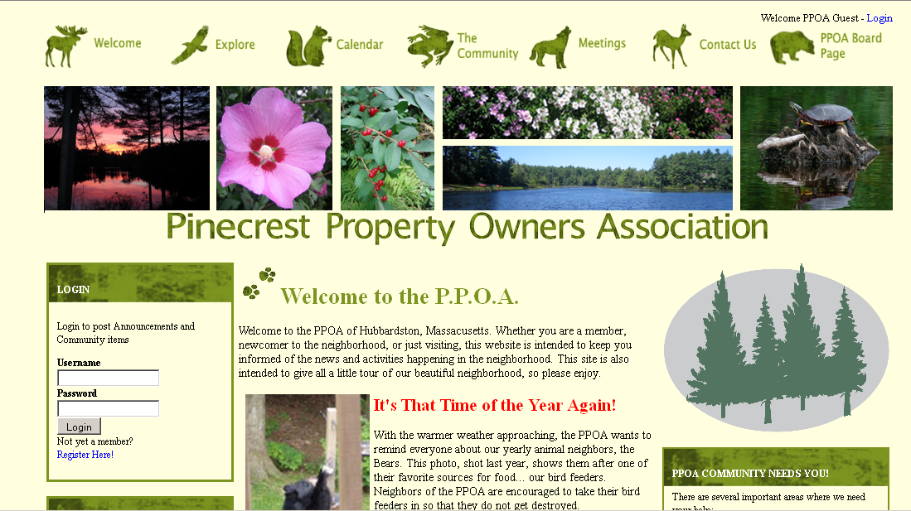
http://ppoa.info/

Slide 2
2012 Pinecrest Property Owners Association Annual Meeting
Sunday May 6, 2012

Slide 3
Agenda
Welcome and introduction of new members 3:00
Minutes of 2011 PPOA Annual Meeting 3:02
Treasurer’s Report 3:04
Review Balance Sheet 3:10
Actual income and Expenses Fiscal Year 2012 3:15
Review Projected Budget for Fiscal Year 2013 3:25
Vote on Fiscal Year 2013 Budget 3:35
Finished Business 3:45
New Business 3:50
Announcement 4:15
Upcoming Events 4:30
Voting 4:45
Q&A 4:50
50/50 Raffle rResults 4:59
Adjournment 5:00
After the meeting, you are welcome to stay for an historical presentation by Dennis Majikas

Slide 4
Treasurer’s Report
March 31, 2012
Account | Balance: | Portfolio Total: | FYTD Income/ Interest Earned
GFA Checking | $1,823.05 |  | $1.06
GFA Savings | $4,543.91 | $6,366.96 | $24.31
Merrill Lynch Money Account | $660.78
Merrill Lynch Cash Balance | $2,961.01
Merrill Lynch Investments | $153,707.82 | $157,329.61
TOTAL |  | $163,696.57

Slide 5
Annual Portfolio

Slide 6
Income

Slide 7
Operating Budget

Slide 8
FY 2012 Budget as if 3/31/2012
EXPENSES | PLAN | ACTUAL YTD | VAR. YTD | INCOME | PLAN | ACTUAL YTD | VAR. YTD
Town of Hubbardston Taxes | $ 2,651.00 | $ 2,662.58 | $ (11.58) | Payments FY 2011 | $ 14,000.00 | $ 13,678.00 | $ (322.00)
United Site Services (Porta Potti) | $ 406.00 | $ 367.51 | $ 38.49 | Lodge Rentals | $ 900.00 | $ 840.00 | $ (60.00)
Comm of Mass (Corp. Fee) | $ 15.00 | $ 15.00 | $ - | Lions Lodge Rental | $ 700.00 | $ 700.00 | $ -
Verizon (Telephone) | $ 826.00 | $ 779.29 | $ 46.71 | Beach Party | $ 85.00 | $ 84.00 | $ (1.00)
National Grid (Electric) | $ 590.00 | $ 534.64 | $ 55.36 | Interest (GFA Checking) | $ 8.00 | $ 0.89 | $ (7.11)
Allied Waste (Trash) | $ 258.00 | $ 271.50 | $ (13.50) | Interest (GFA Savings) | $ 35.00 | $ 24.04 | $ (10.96)
(Lodge Security) | $ 204.00 | $ 204.00 | $ - | Interest (Merrill Lynch) | $ 10.00 | $ 1.56 | $ (8.44)
USPS | $ 175.00 | $ - | $ 175.00 | Dock fees | $ 50.00 | $ 100.00 | $ 50.00
Broberg Insurance (Liability) | $ 4,218.00 | $ 4,209.60 | $ 8.40 | Miscellaneous | $ 100.00 | $ 506.00 | $ 406.00
Broberg Insurance (Lodge replacement) | $ 936.00 | $ 996.00 | $ (60.00)
Huhtula Oil (Fuel) | $ 1,400.00 | $ 673.23 | $ 726.77 | TOTAL INCOME | $ 15,888.00 | $ 15,934.49 | $ 46.49
PO Box | $ 46.00 | $ 46.00 | $ -
Berkshire Lab (Beach water testing) | $ 320.00 | $ 352.00 | $ (32.00)
US Treasury (Taxes) | $ 100.00 | $ - | $ 100.00 | MAINTENANCE & IMPROVEMENTS
Commonwealth of MA (Taxes) | $ 500.00 | $ 456.00 | $ 44.00 | Kitchen hot water heater | $ 400.00 | $ 462.41 | $ (62.41)
Lodge inspection: Town of Hubbardston | $ 40.00 | $ - | $ 40.00 | Beach sand/signs | $ 300.00 | $ 71.77 | $ 228.23
Beach fee: Town of Hubbardston | $ 75.00 | $ 75.00 | $ - | Clean Furnace | $ 90.00 | $ 131.68 | $ (41.68)
Dam State Fees | $ 150.00 | $ - | $ 150.00 | barn window repair |  | $ 200.00 | $ (200.00)
Legal (Advice) | $ 200.00 | $ - | $ 200.00 | Lodge monthly cleaning | $ 300.00 | $ 200.00 | $ 100.00
Miscellaneous | $ 225.00 | $ 730.15 | $ (505.15)
Easter Party | $ 175.00 | $ 98.67 | $ 76.33 | TOT. MAINTENANCE & IMPROVEMENTS | $ 1,090.00 | $ 1,065.86 | $ 24.14
Halloween Party | $ 125.00 | $ - | $ 125.00
Beach Party | $ 600.00 | $ 530.77 | $ 69.23 | TOTAL EXPENSES | $ 15,713.00 | $14,067.80 | $ 1,645.20
Sliding party | $ 100.00 | $ - | $ 100.00 | TOTAL INCOME | $ 15,888.00 | $15,934.49 | $ 46.49
Lien settlement recording fee | $ 150.00 | $ - | $ 150.00
Stationary | $ 15.00 | $ - | $ 15.00 | NET CASH FLOW | $ 175.00 | $ 1,866.69 | $ 1,691.69
Web Site | $ 123.00 | $ - | $ 123.00
 |  |  | $ -
SUB TOTAL EXPENSE (Operating Plan) | $ 14,623.00 | $13,001.94 | $ 1,621.06
 |  |  |  | Misc income is tax abatement
 |  |  |  | Aquatic Control Technology $6482.63

Slide 9
FY 2013 Budget
EXPENSES | PLAN | ACTUAL YTD | VAR. YTD | INCOME | PLAN | ACTUAL YTD | VAR. YTD
Town of Hubbardston (Taxes) | $ 2,300.00 | $ - | $ 2,300.00 | Payments FY 2011 | $ 13,678.00 | $ - | $ (13,678.00)
United Site Services (Porta Potti) | $ 375.00 | $ - | $ 375.00 | Lodge Rentals | $ 840.00 | $ - | $ (840.00)
Comm of Mass (Corp. Fee) | $ 15.00 | $ - | $ 15.00 | Lions Lodge Rental | $ 700.00 | $ - | $ (700.00)
Verizon (Telephone) | $ 780.00 | $ - | $ 780.00 | Beach Party | $ 20.00 | $ - | $ (20.00)
National Grid (Electric) | $ 545.00 | $ - | $ 545.00 | Interest (GFA Checking) | $ 8.00 | $ - | $ (8.00)
Allied Waste (Trash) | $ 280.00 | $ - | $ 280.00 | Interest (GFA Savings) | $ 35.00 | $ - | $ (35.00)
Lodge Security | $ 208.00 | $ - | $ 208.00 | Interest (Merrill Lynch) | $ 10.00 | $ - | $ (10.00)
USPS (Stamps) | $ 178.00 | $ - | $ 178.00 | Dock fees | $ 100.00 | $ - | $ (100.00)
Broberg Insurance (Liability) | $ 4,417.60 | $ - | $ 4,417.60 | Miscellaneous | $ 100.00 | $ - | $ (100.00)
Broberg Insurance (Lodge replacement) | $ 1,042.80 | $ - | $ 1,042.80
Huhtula Oil (Fuel) | $ 800.00 | $ - | $ 800.00 | TOTAL INCOME | $ 15,491.00 | $ - | $ (15,491.00)
PO Box | $ 47.00 | $ - | $ 47.00
Berkshire Lab (Beach water testing) | $ 359.00 | $ - | $ 359.00
US Treasury (Taxes) | $ 100.00 | $ - | $ 100.00 | MAINTENANCE & IMPROVEMENTS
Commonwealth of MA (Taxes) | $ 460.00 | $ - | $ 460.00
Clean furnace | $ 150.00 | $ - | $ 150.00 | Beach sand | $ 300.00 | $ - | $ 300.00
Lodge inspection: Town of Hubbardston | $ 40.00 | $ - | $ 40.00 | Lodge monthly cleaning & supplies | $ 450.00 | $ - | $ 450.00
Beach fee: Town of Hubbardston | $ 75.00 | $ - | $ 75.00 | Clingons (Auto ID's | $ 210.00 | $ - | $ 210.00
Legal (Advice) | $ 200.00 | $ - | $ 200.00 | Signs | $ 400.00 | $ - | $ 400.00
Miscellaneous | $ 225.00 | $ - | $ 225.00 | Tractor fuel & mowing supplies | $ 350.00 | $ - | $ 350.00
Easter egg hunt | $ 100.00 | $ - | $ 100.00
Halloween party | $ 125.00 | $ - | $ 125.00 | TOT. MAINTENANCE & IMPROVEMENTS | $ 1,710.00 | $ - | $ 1,710.00
Beach Party | $ 150.00 | $ - | $ 150.00
Sliding party | $ 55.00 | $ - | $ 55.00 | TOTAL EXPENSES | $ 15,082.40 | $ - | $ 15,082.40
Lien settlement recording fee | $ 150.00 | $ - | $ 150.00 | TOTAL INCOME | $ 15,491.00 | $ - | $ (15,491.00)
Stationary | $ 15.00 | $ - | $ 15.00
Web Site | $ 30.00 | $ - | $ 30.00 | NET CASH FLOW | $ 408.60 | $ - | $ (408.60)
CPA | $ 150.00 | $ - | $ 150.00
SUB TOTAL EXPENSE (Operating Plan) | $ 13,372.40 | $ - | $ 13,372.40

Slide 10
CAPITAL PLAN
Projects | Calendar Year | Plan | Actual
Obtain permits to treat pond to eradicate invasive weeds | 2011 | $ 3,000 | $ 3,000
Initial treatment | 2011 | $ 8,500 | $ 8,500
Second treatment | 2012 | $ 3,500
Repair upper dam | TBD
Repair lower dam | TBD
Replace beach playground | TBD
Inspect & repair septic system at lodge | TBD

Slide 11
TOTAL NET WORTH
Real Estate $651,803
Total portfolio $163,696
Total assets $815,499
Total liability $0
Net worth $815,499

Slide 12
Thank You

